Slide 1

A New Value Proposition for the AMA

Slide 2
Outline
Current Challenges
AMA’s Role in Healthcare Reform
Needs of the providers, practitioners, and patients
Measuring value and enabling value throughout healthcare
Engaging providers, practitioners, and patients
Expanding the reach and membership of the AMA
Moving towards a new business model

Slide 3
Current Challenges
Eroding member base.
Aging membership.
Decline in revenues.
Not perceived as an innovation leader.
Healthcare is fractionalized across the continuum of care.
The government is trying to lead healthcare reform.
Need for clear leadership to drive reform, innovation, and unification across the healthcare continuum.

Slide 4
AMA’s Role in Healthcare Reform
A relevant voice that should be heard by the government.
Provide healthcare stakeholders with the following answers:
  Practitioners are worried about quality, timeliness, and effort of care
  Patients are worried about quality of care, loss of control, and cost
  Providers are worried about loss of control and revenue
Opportunity for unifying leadership to provide guidance and direction for change (much of which will be disruptive).
Opportunity to encourage collaboration and cooperation to solve the healthcare needs in the US and across the world.
Opportunity to create a “system” of healthcare guided by consistent value-driven metrics (outcomes).

Slide 5
Needs of the Patients
To have affordable healthcare.
To have attainable healthcare.
To have more accessible healthcare.
To have consistent levels of quality (results).
To receive a total healthcare experience:
  Ensure their functional outcomes met.
  Ensure their emotional outcomes met.
  Ensure their outcomes are met across the continuum of care (beyond the hospital, into clinics, and into the home).

Slide 6
Needs of the Practitioners
To improve diagnostic capabilities in a cost-effective manner.
To improve clinical processes.
To provide consistent levels of quality.
To move beyond service, where they can deliver a positive experience.
To be able to reliably measure value for their patients, for themselves as individual practitioners , and for their practices.

Slide 7
Needs of the Providers
To get pharmaceutical and device manufacturers, insurers, and healthcare suppliers to become aligned, unified and collaboratively focused on a consistent set of outcomes.
To increase collaboration NOT competition.
To understand how to identify, measure and deliver value throughout the healthcare value network.
To move towards a shared revenue model where everyone can still win, but not at the expense of others (esp. the patients & the public).

Slide 8
AMA’s Opportunity to enable Value
Innovate current business model to address the needs of the patients, practitioners, and the providers (3Ps).
Use a disciplined process to capture and assess the needs of the 3Ps in a quantifiable manner.
Provide a centralized repository of unbiased needs of the 3Ps to identify opportunities for measuring & creating value in US healthcare.
License the repository information to the 3Ps to build a self-sustaining model for improving value delivery in healthcare
Guide (and possibly drive) innovation in healthcare to create new value, while reducing the overall costs for the 3Ps.

Slide 9
AMA at the forefront of Healthcare
Defining & delivering the prescription for healthcare reform should come from within healthcare (not the government).
Creating a vision for a new healthcare system by forming a collaborative model with healthcare advocacy organizations, institutions, providers and practitioners.
Providing the practitioners with a consistent set of benchmarks for measuring the value they deliver to patients.
Driving open innovation among providers to create a more efficient process for guiding and creating value.
Working collaboratively with the government to guide more efficient and effective funding that drives healthcare reform.

Slide 10
Moving from Assumptions to Implementation
Establish a program focused on mapping the Jobs & Outcomes across the healthcare domain.
Build a portfolio of unmet needs (opportunities) for improving value delivery to patients and practitioners.
Establish a prioritization model to direct resources in an efficient manner.
Create an open innovation framework using the opportunities to generate ideas that can address the most important (prioritized) unmet needs.
Establish a shared revenue model as part of a collaborative to address unmet needs.

Slide 11
Value Measurement Platform for Healthcare
Healthcare Domains
Prevention
Diagnostics
Treatment
Maintenance
Federated Portfolio of Jobs & Outcomes
(Patients & Practitioners)
Jobs
Outcomes
Value is measured through Outcomes => Outcomes are used to enable value

Slide 12
Measuring Value for Healthcare
Build a portfolio of jobs & outcomes:
  For measuring value
  For capturing customer* needs
  For guiding innovation
  * The focus is on Patients and Practitioners in the Healthcare Value Network

Slide 13
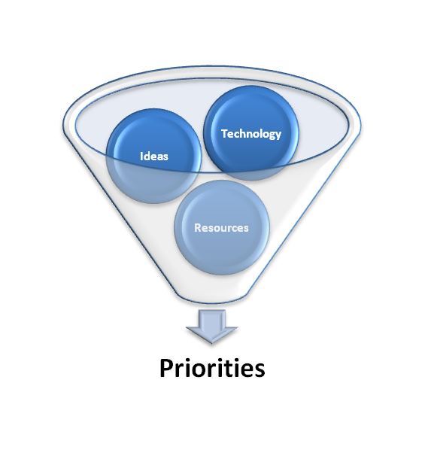
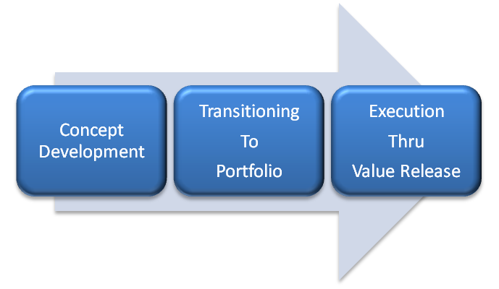




Enabling Value for Healthcare
Healthcare Value Platform
Outcomes
Compliance
Rules
Efficient value delivery for transforming healthcare and driving value

Slide 14
Enabling Value for Healthcare
Build an innovation portfolio to drive value by:
  Creating a portfolio of outcomes that can be used by the 3 Ps to measure value.
  Creating a portfolio of opportunities (IP)*.
  Leveraging open innovation to create a portfolio of ideas to address unmet needs.
  Engaging innovators in a collaborative effort to create new products and services to solve the most important needs in healthcare.
  Aligning sustainable value delivery within a system of healthcare.

Slide 15
Engaging Providers & Innovators
Identifying priorities for healthcare upfront can:
  Reduce the risks for investments in new products and services.
  Focus 3rd party resources more efficiently.
  Reduce the costs associated with investment planning.
  Reduce the cycle time for new products & services addressing the most important needs in healthcare.

Slide 16
Engaging Providers & Innovators
Using a managed IP model will:
  Encourage open innovation to leverage mindshare across all disciplines to solve the healthcare needs.
  Promote collaboration instead of competition for new products & services to:
    Bring new efficiencies to research and development.
    Reduce the costs and cycle time.
    Level the intellectual capital (IC) playing field for all providers and innovators.

Slide 17
Engaging Practitioners & Patients
Using a repository of outcomes will:
  Provide practitioners with a consistent set of metrics for measuring value with precision:
    Covering the realm of healthcare locations (hospitals, clinics, alternate site, and home)
    Covering the breadth of healthcare practitioners (physicians, nurses, pharmacists, specialists, etc.)
    Covering the flow of patients and the care they receive across the continuum of healthcare
  Provide the AMA with a consistent benchmark for evaluating healthcare products and services

Slide 18
Engaging Practitioners & Patients
Using a repository of outcomes will:
  Provide patients with a consistent benchmark for selecting products, services, and practitioners to meet their healthcare needs.
  Provide consistent outcomes and quality of care from prevention to support (continuum of care) for all patients.

Slide 19
Expanding the AMA membership model
The AMA intellectual property (IP) repository will provide the AMA with a unique value proposition to secure existing members and draw additional participants from across the healthcare value network (including patients) to expand the AMA’s membership and revenue potential.

Slide 20
Expanding the AMA membership model
Access to the information in the AMA intellectual property (IP) repository will:
  Draw practitioners so they can more efficiently and effectively review and select products and services that can help them meet the patient outcomes.
  Draw patients so they can review value-driven measures about providers, practitioners, products and services to make informed choices about their healthcare needs.

Slide 21
Expanding the AMA membership model
Access to the information in the AMA intellectual property (IP) repository will:
  Draw providers so they can optimize their IC processes to deliver more efficient and effective value to practitioners and patients.
  Draw membership from private and public sectors who are interested in leveraging information to optimize care for their employees.

Slide 22
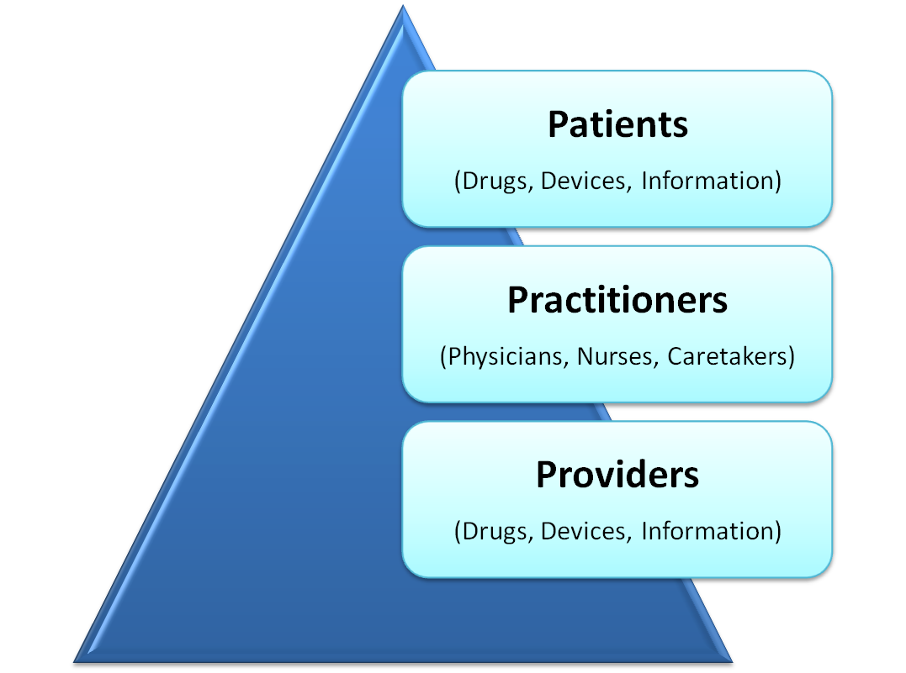
An Expanded Membership Model
Providing Patients with a way to measure the value they should be receiving for healthcare throughout the continuum
Guiding Practitioners to measure and optimize the value they deliver to Patients
Guiding the Providers to deliver value to Patients & Practitioners
AMA

Slide 23
Reducing Costs & Driving Value
Today…
  Participants in the healthcare value network create value based on their own perceived understanding of customer needs.
Tomorrow…
  The AMA can provide a beacon of leadership to:
    Understand customer needs throughout healthcare
    Guide providers to build the right products & services
    Deliver value to customers* throughout the healthcare continuum
* Practitioners & Patients

Slide 24
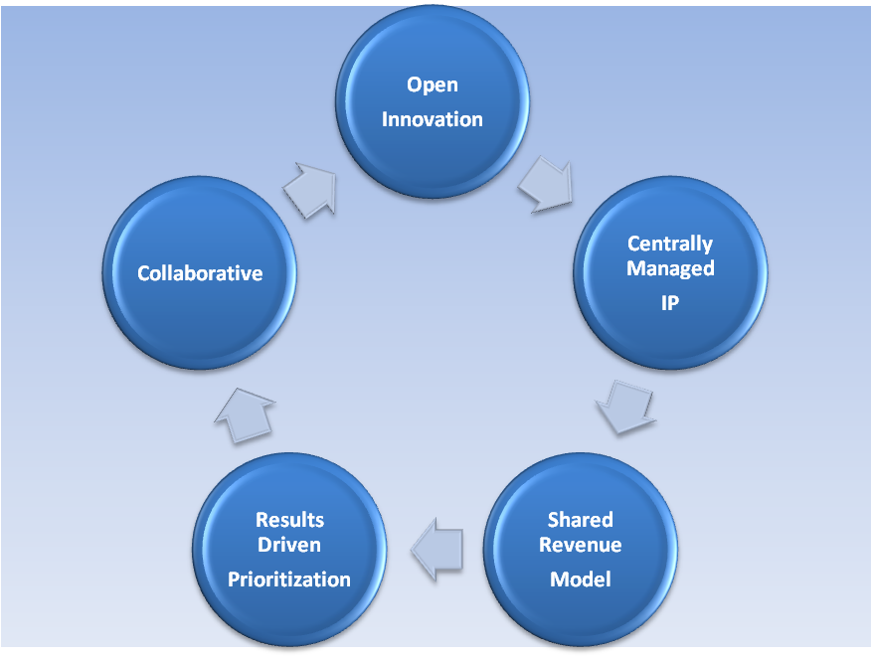

A New Business Model for Creating Value
Provides new value creation
Repositioned for leading healthcare change
Relevant to all Providers, Practitioners, and Patients
Provides thought leadership for guiding change and innovation
Orchestrates a unified value network for delivering efficient, affordable, and accessible healthcare to meet the unmet needs of customers
Ensures value can be measured, improved, and sustained

Slide 25



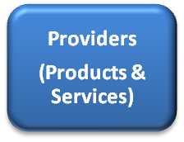


Positioning the AMA to Lead Healthcare Reform
Advocacy Body for:
  Value enablement
  Value capture & measurement
  Collaboration
  Unification & cooperation
  Reform & Sustainable Innovation
Enabling Value
Driving Innovation

Slide 26
Thank You
Prepared by
  Jeffrey Wallk (Managing Partner)
  Helene Sigman (Strategic Partner)

